Slide 1
How to automate data analyses and save your life time
Cecilia (XinYue) Wang
Department of Microbiology and Immunology

Slide 2
Cross river

Slide 3
Do you…
Have massive number of files to process
Need to run the same type of analyses using the same set of files but need to change some parameters for each run
Run multiple steps of data analyses one at a time because each step is based on the results from the previous step
Need to combine hundreds of spread sheets before doing stats but don’t want to do that in Excel.

Slide 4
These may help:
A (good) computer or access to a server or super computer service
Have reasonable amount of storage space for your data
Willing to learn how to use new tools and techniques

Slide 5
Do you…
Have massive number of files to process
Running the same type of analyses using the same set of files but need to change some parameters for each run
Run multiple steps of data analyses one at a time because each step is based on the results from the previous step
Need to combine hundreds of spread sheets before doing stats but don’t want to do that in Excel.

Slide 6
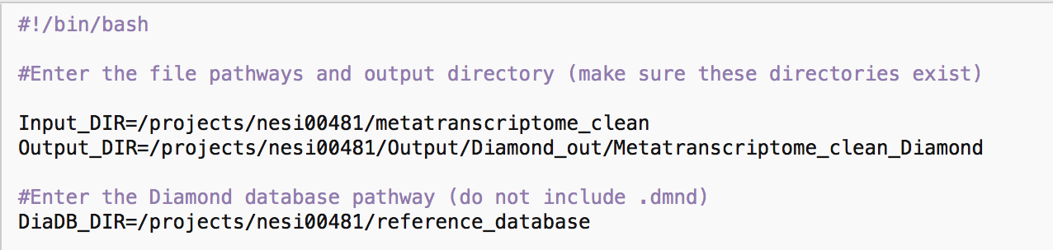
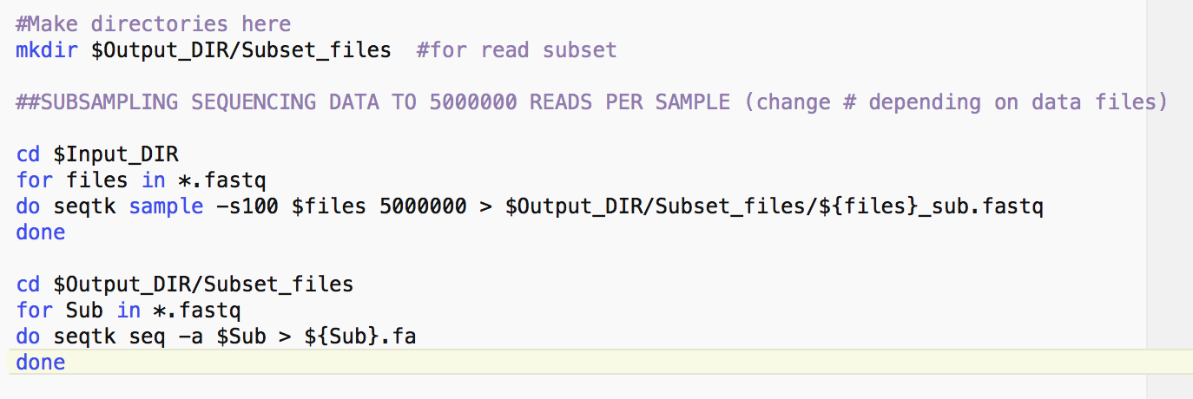
Bash Script #!/bin/bash
Notes:
Use # for comments
Use $ for variable substitution
Use ${} for Parameter substitution
Use Special Characters
Use loops
Run parallel
Set up necessary directories
Create subfolders, change work directory and set up loops

Slide 7
Bash Script #!/bin/bash
Notes:
Use # for comments
Use $ for variable substitution
Use ${} for Parameter substitution
Use Special Characters
Use loops
Run parallel
Set up necessary directories
Create subfolders, change work directory and set up loops
Why this can save your time?
Don’t have to do extra work to record what you did for each step.
If you need to do same thing for other datasets, simply change the input and output directories and everything else is automatic
Easy to do small change with parameters and rerun
Don’t have to name every single result file

Slide 8
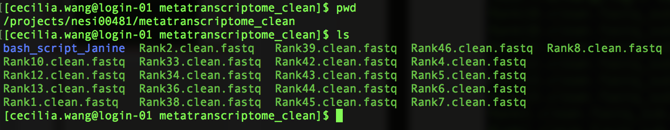
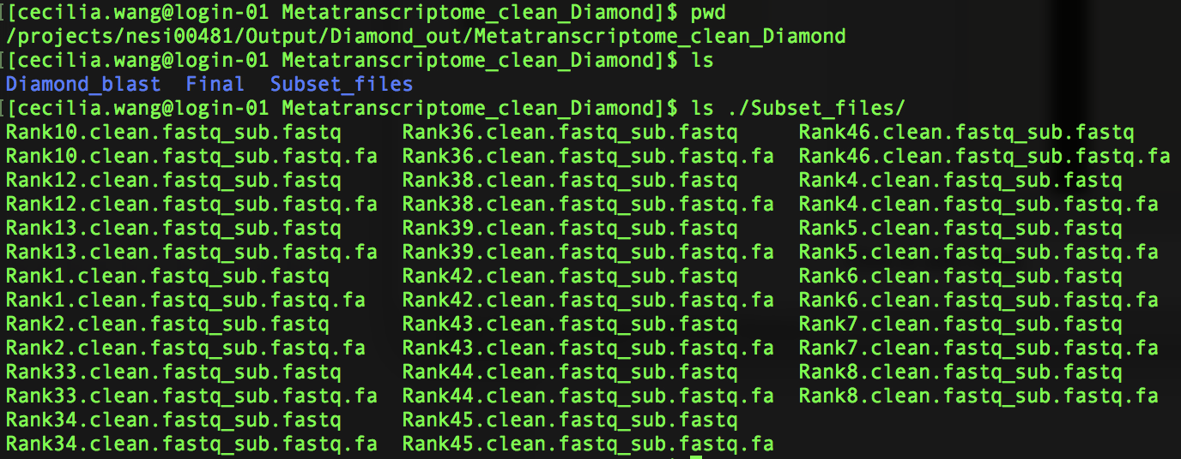
Output
Input files
Output files

Slide 9
Do you…
Have a hundred files to process
Running the same type of analyses using the same set of files but need to change some parameters for each run
Run multiple steps of data analyses one at a time because each step is based on the results from the previous step
Need to combine hundreds of spread sheets before doing stats but don’t want to do that in Excel.

Slide 10
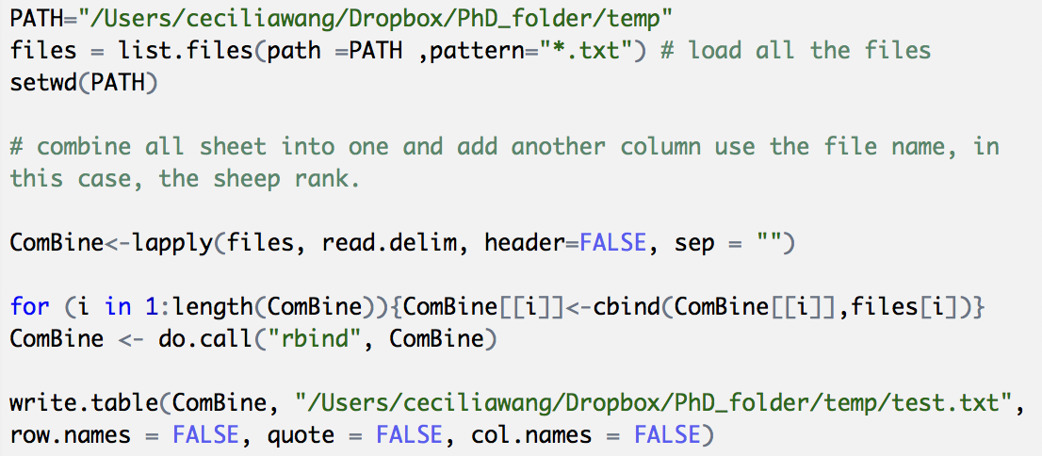
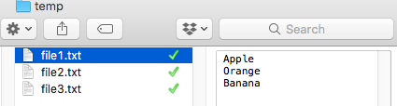
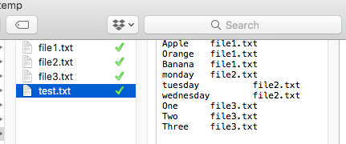
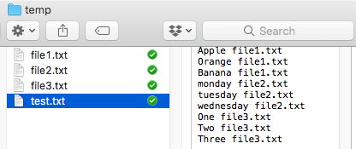
Bash R
cd /Users/ceciliawang/Cecilia/temp
awk '{print $0,"\t", FILENAME}' file*.txt >test.txt

Slide 11
Which one to pick? For example:
Unix/Linux
Massive data files (e.g. sequencing files)
Intensive blasting or converting
Generic summary for large number of files
R
Small file(s)
Mainly statistical analyses
Fine touch on dataset(s) details
Pretty figures

Slide 12
Which one to pick?
Unix/Linux
Massive data files (e.g. sequencing files)
Intensive blasting or converting
Generic summary for large number of files
R
Small file(s)
Mainly statistical analyses
Fine touch on dataset(s) detailes
Pretty figures
Whichever makes your life easier

Slide 13
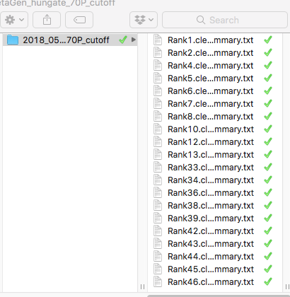
Example: Hydrogenase activities in rumen
Input files
Examples

Slide 14
Take home message
Spend time to have fun in science.
Let the computer do the
boring repeatable part.

